Slide 1


Automated system partitioning based on hypergraphs for 3D stacked integrated circuits
FOSDEM 2018 – Quentin Delhaye

Slide 2
Integrated circuits: Let’s go 3D

Slide 3
Building an Integrated Circuit (IC)
Transistors to
build gates

Slide 4
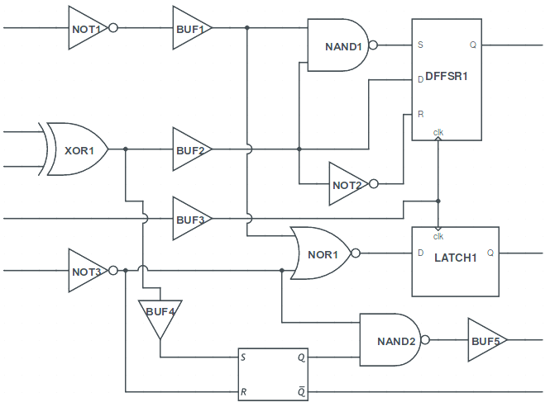
Building an Integrated Circuit (IC)
Transistors to
build gates
Gates to build
logic functions

Slide 5
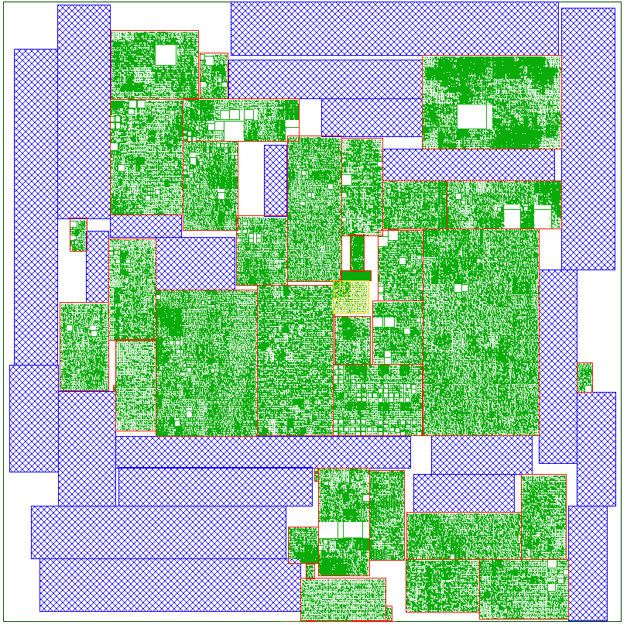
Building an Integrated Circuit (IC)
Transistors to
build gates
Gates to build
logic functions
Logic functions
build ICs

Slide 6
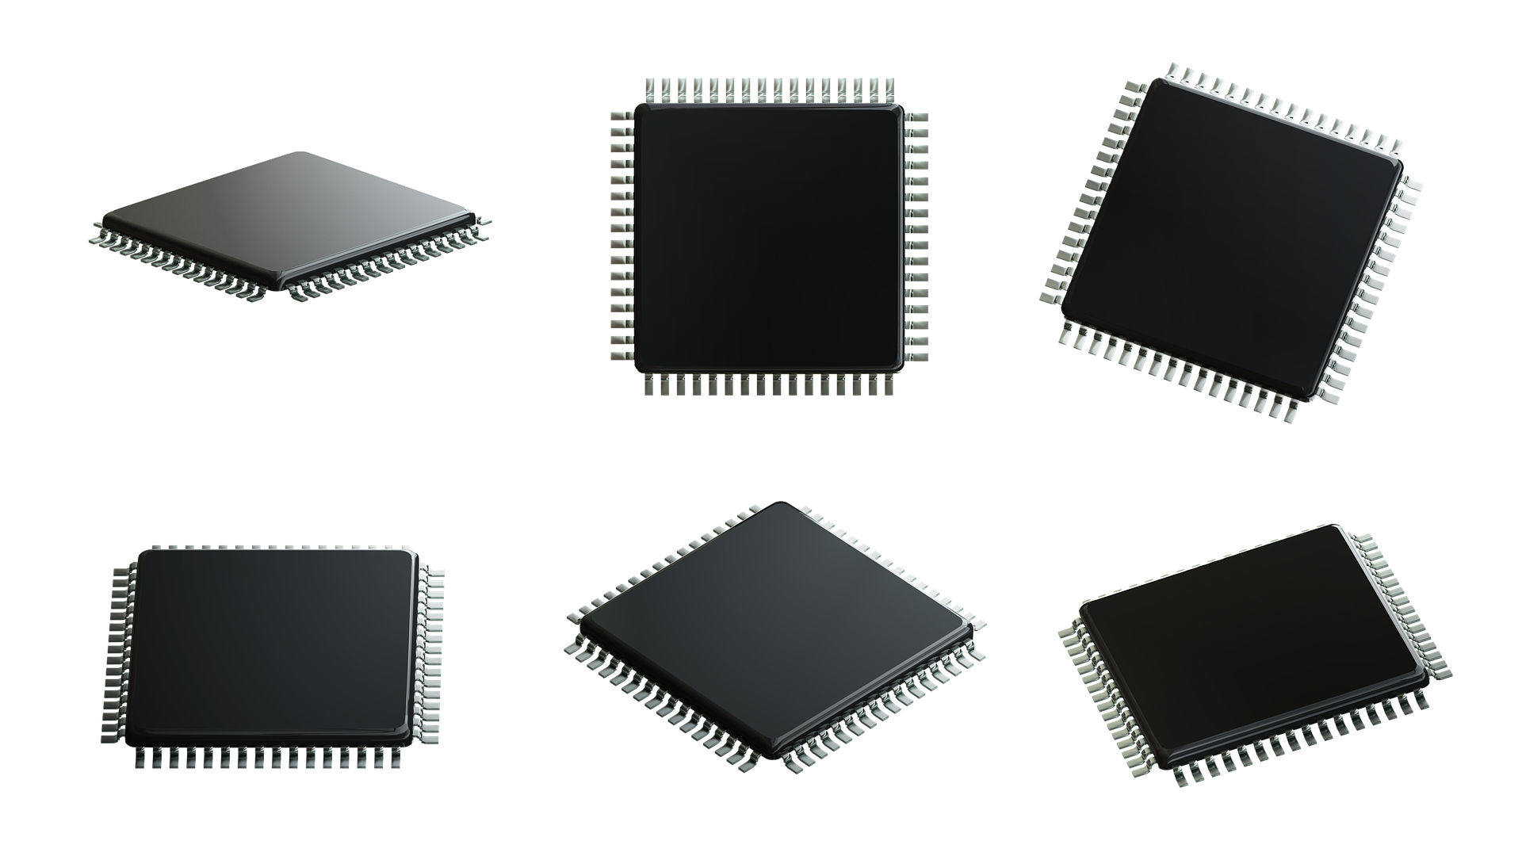
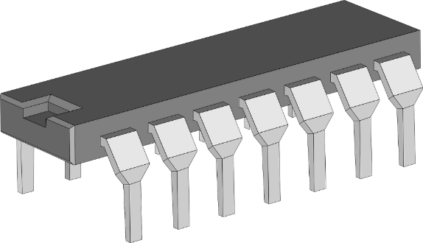
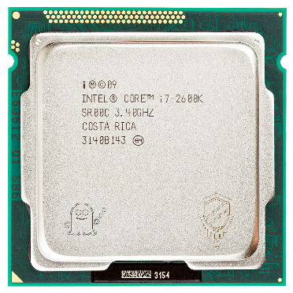
Building an Integrated Circuit (IC)
Transistors to
build gates
Gates to build
logic functions
Logic functions
build ICs
Notes:
DIP (dual inline package), QFP (quad flat package), LGA (lang grid array).
Hi Spectre and Meltdown.

Slide 7
Building an Integrated Circuit (IC)
Transistors to
build gates
Gates to build
logic functions
Logic functions
build ICs
System performance depends on transistor performance and the quality of the system interconnect
Notes:
DIP (dual inline package), QFP (quad flat package), LGA (lang grid array)

Slide 8
What does a 2D IC look like?
Metal
Gate
Substrate
Planar 2D IC: only one transistor layer

Slide 9
What are its limitations?
Standard
cell
Metal
layers
Metal
pitch
If you want more of them,
you need them smaller.
Fin
pitch
But scaling has physical
and financial limitations.
Gate
pitch
Notes:
Metal pitch is the distance between two adjacent tracks on the same metal layer.

Slide 10
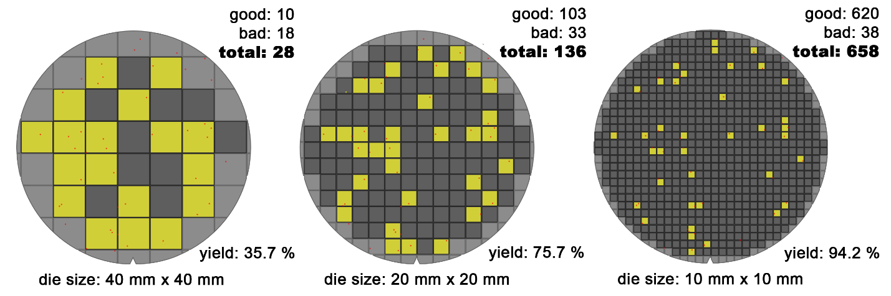
You can’t simply make it bigger
Good die
Bad die
Constant amount of defects per wafer
Larger IC means lower yield

Slide 11
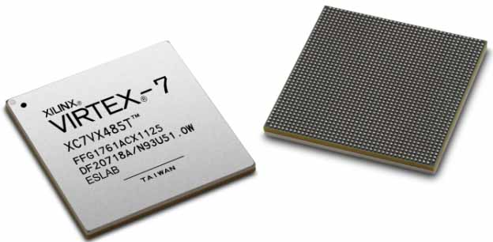
Split the IC to keep it small
Xilinx split its latest node to keep it relatively affordable.
FPGA
FPGA
FPGA
FPGA
FPIC
FPIC
FPIC
Notes:
Hello Xilinx: https://www.xilinx.com/products/silicon-devices/3dic.html
Le design trop gros pour un seul FPGA est abordé à la section 2.6 de “VLSI Physical Design” de Kahng. On peut utiliser des FPIC (Field-Programmable Interconnect Chips) pour les interconnecter. Interviennent alors les problèmes d’opitmisation de l’utilisation des FPGA ainsi que la minimisation des interconnections afin de réduire l’utilisation des I/O qui sont en nombre limité.

Slide 12

What is a 3D IC?
Notes:
OK, now we get why we can’t stick with 2D and need to split the design.
How do I turn this...

Slide 13
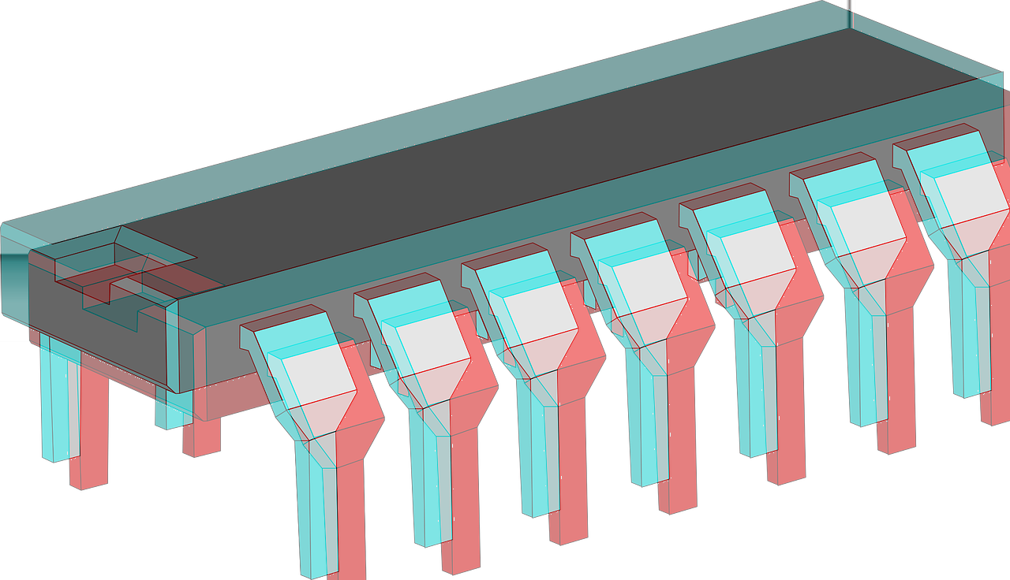
What is a 3D IC?
Notes:
...into 3D.
(but real 3D, not stereoscopic)

Slide 14
What is a 3D IC?

Slide 15
What is a 3D IC?
Face-to-Back (past)

Slide 16
What is a 3D IC?
Face-to-Back (past)
Face-to-Face (present)

Slide 17
What is a 3D IC?
Face-to-Back (past)
Face-to-Face (present)
Transistor-on-transistor
(future)

Slide 18
What is a 3D IC?
Face-to-Back (past)
Face-to-Face (present)
Transistor-on-transistor
(future)
Somebody needs to decide what goes where

Slide 19
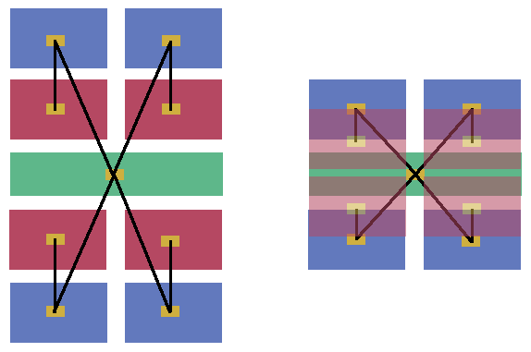
3D benefit: shorter connections
Increased performance
Decreased system power consumption
Improved area utilisation
Notes:
Shorter connections because all the blocks are closer to each other: Red and Blue get stacked, Blue and Green get closer on the same layer thanks to Red moving to another layer.

Slide 20
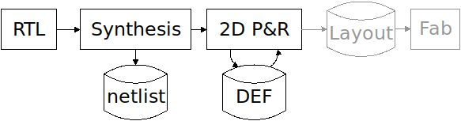
2D flow...
Hardware description: Verilog, VHDL, ...

Slide 21
2D flow...
Synthesis: Yosys, ODIN-II, ABC, ...
Yields a netlist.

Slide 22
2D flow...
Place and route (P&R): QRouter, Graywolf, FGR, ...

Slide 23
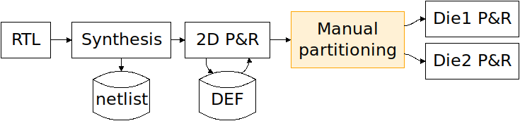

... Extended to 3D
Pick which standard cell or module goes where

Slide 24
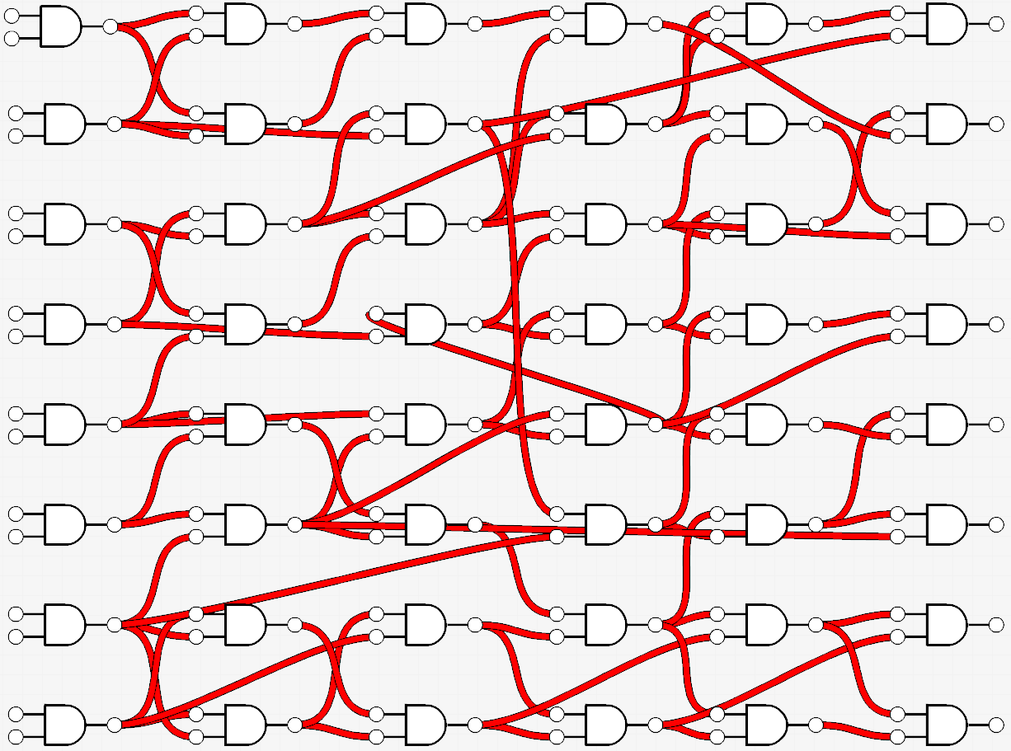
This is not a design.
Notes:
Hi Magritte.

Slide 25
Bipartition this system
Objectives:
Area balance
Limit 3D interconnectivity
Notes:
Dans notre partitionnement, on ne veut pas couper les petits fils parce qu’une fois passés en 3D, ces petits fils seront plus long qu’en 2D.
Le clustering permet donc de mettre en évidence les longs fils et de cacher les petits (les locaux).

Slide 26

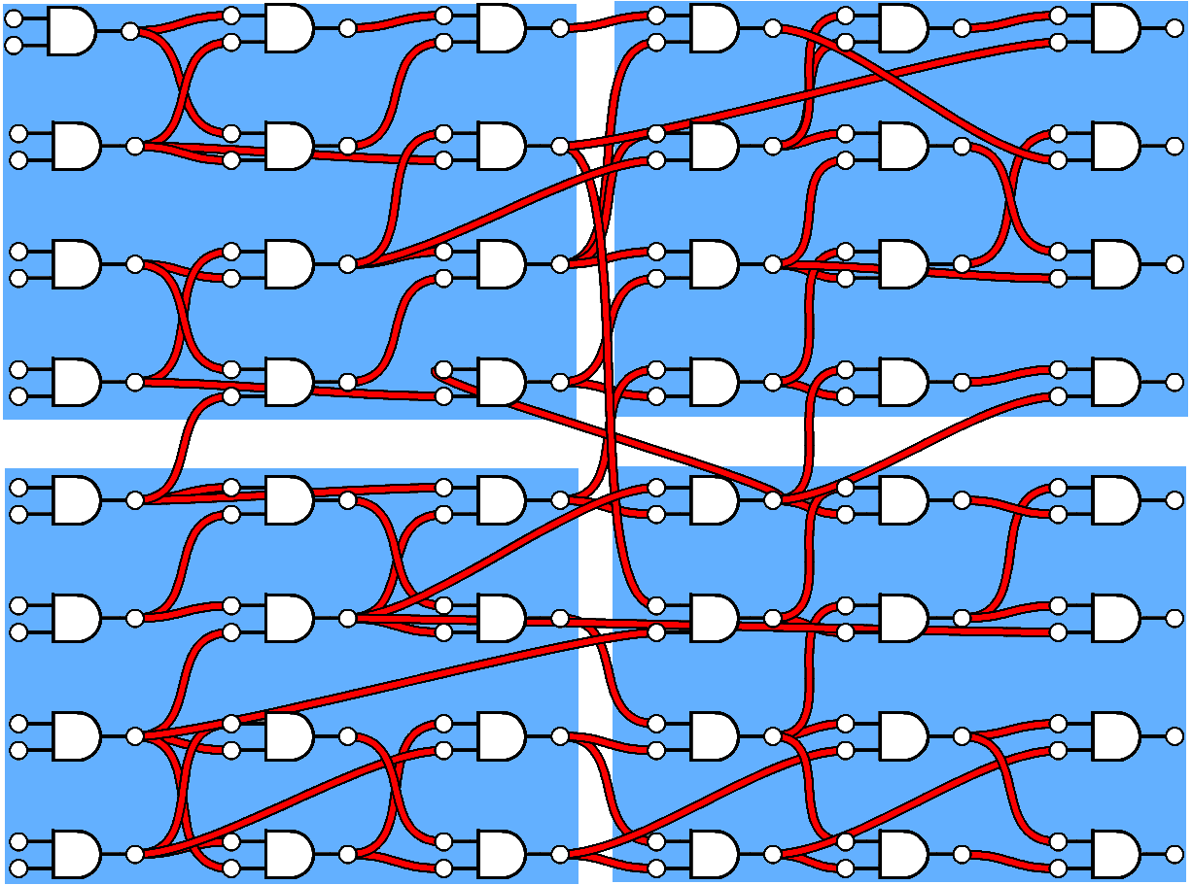
Clustering: hide the shortest nets
Big clusters:
Few nets ☺
Long nets hidden ☹
Notes:
Dans notre partitionnement, on ne veut pas couper les petits fils parce qu’une fois passés en 3D, ces petits fils seront plus long qu’en 2D.
Le clustering permet donc de mettre en évidence les longs fils et de cacher les petits (les locaux).

Slide 27
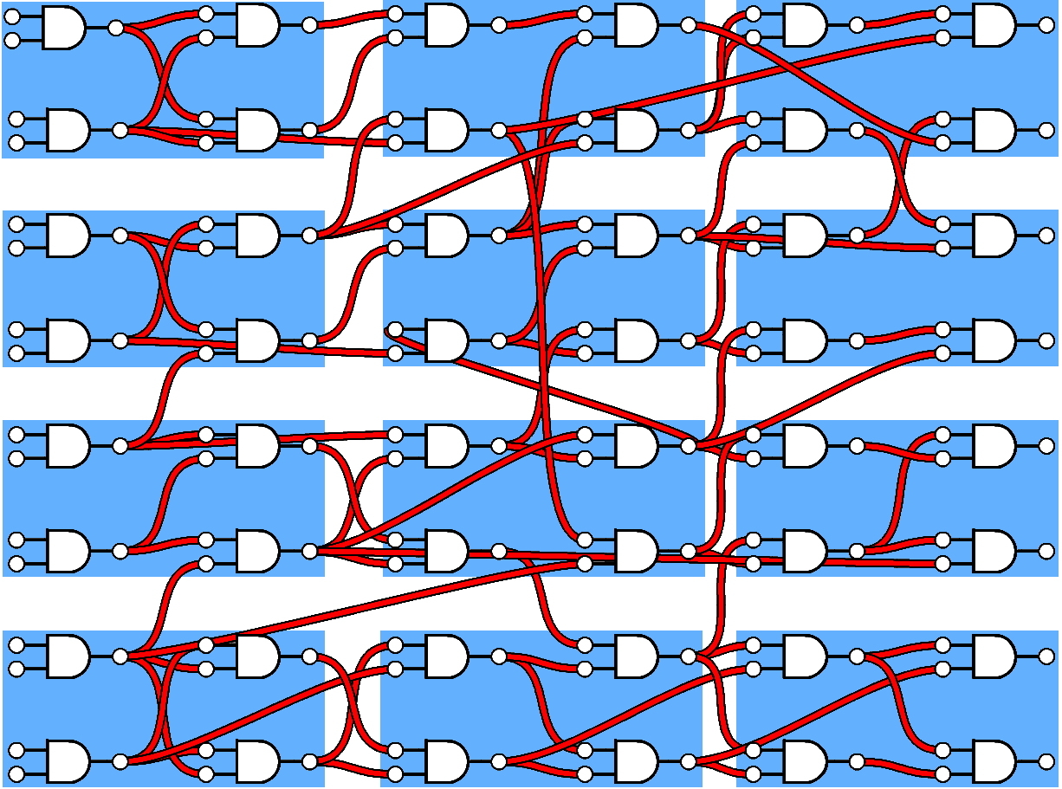
Clustering: hide the shortest nets
Small clusters:
Lots of nets ☹
Long nets apparent ☺
Notes:
Le but étant de ne pas aller trop loin, de trouver l’équilibre entre niveau de clustering permettant un niveau de partitionnement décent (plus petits clusters possibles) et une longueur minimale de fil n’implicant pas de perte de performance lors du passage en 3D (plus grands clusters possibles).

Slide 28

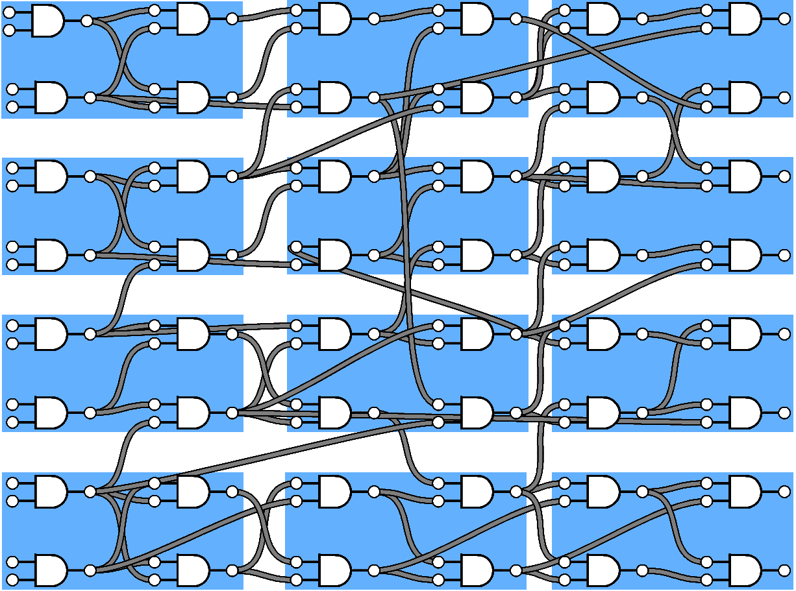
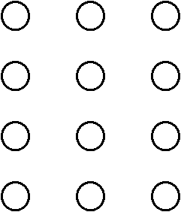
Graph extraction
Clusters become vertices

Slide 29
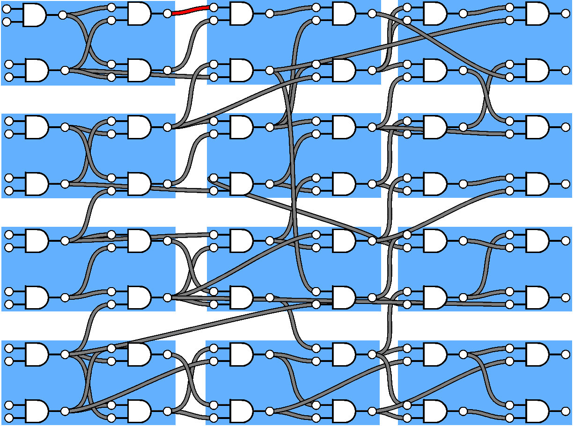
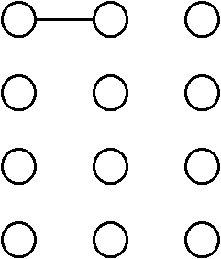
Graph extraction
Interconnections become edges

Slide 30
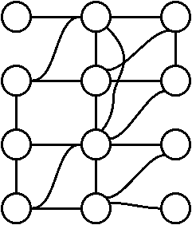
Graph extraction
Extraction complete

Slide 31
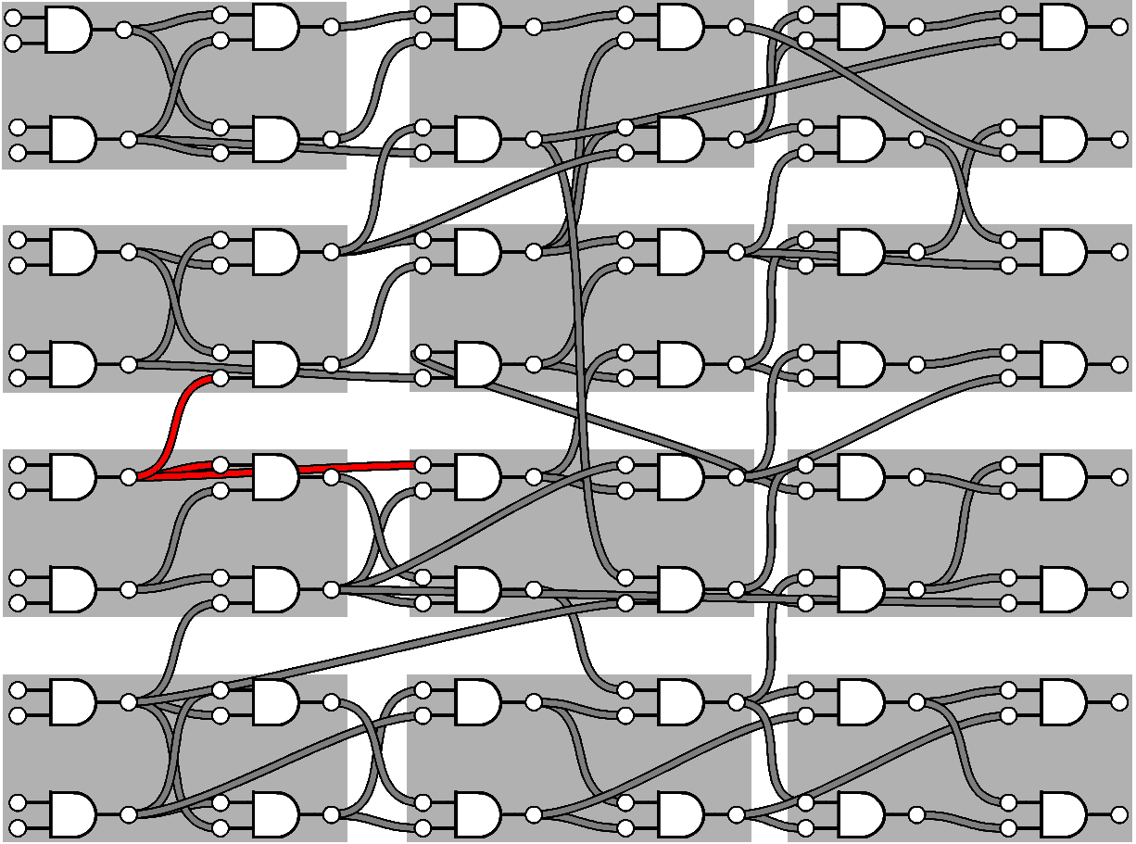
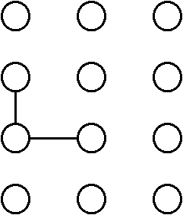
Graph extraction
Single nets are split into different edges

Slide 32
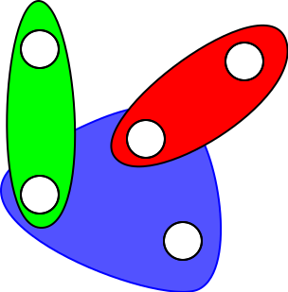
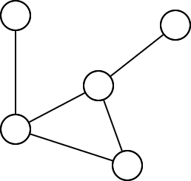
From graph to hypergraph

Slide 33
Graph extraction
Single nets are split into different edges

Slide 34
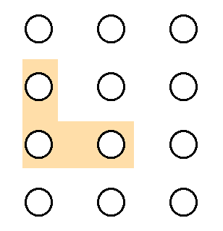
Graph extraction
Hyperedges maintain their integrity

Slide 35
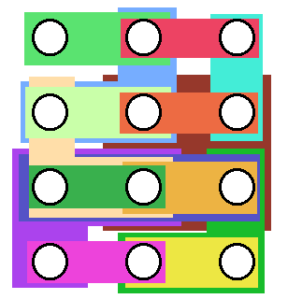
Hypergraph extraction

Slide 36

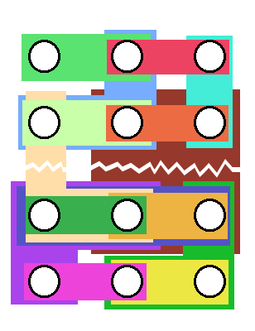
Partitioning
Minimize the crossing nets and maintain area balance

Slide 37

Split the netlist
Die 1
module die1();
module die2();
Die 2

Slide 38
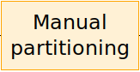
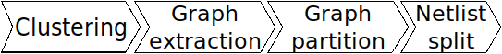
Replace the manual partitioning

Slide 39
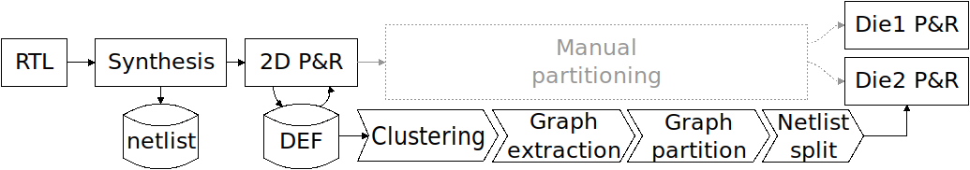

Automated 3D flow

Slide 40

Automated 3D flow
Export design properties
Design clustering
Export clusters connectivity

Slide 41

Automated 3D flow
From the clustering outputs
Build hyperedges and merge identical ones
Compute graph weights
Format graph and call partitioning tool
Export cut data and partition directives

Slide 42
Automated 3D flow
hMETIS
PaToH
Karypis Lab, University of Minesota
Ümit Catalyürek, Bilkent University

Slide 43
Automated 3D flow
Early development stage
Based on 2D netlist and partitioning directives

Slide 44
Designs tested
LDPC
RISC V (BoomCore)
OpenSparc T2: SPC, CCX and RTX

Slide 45
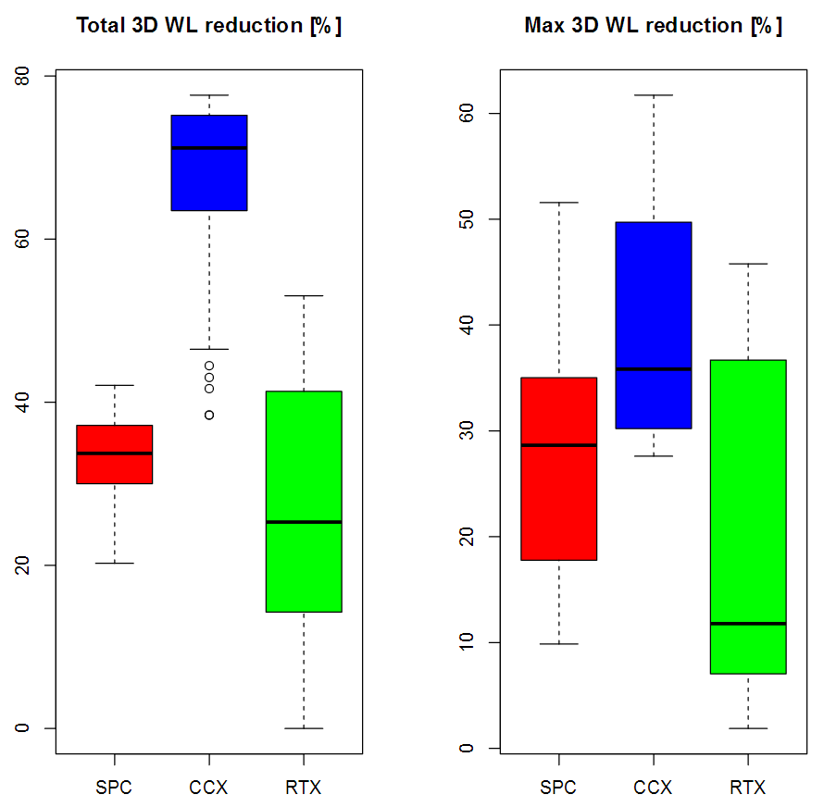
3D: up to 77% less total wire length
Experiments using different functional blocks from OpenSPARC T2 SoC
Different partitioning schemes
Different clustering options

Slide 46
3D: Up to 61% shorter critical path
Experiments using different functional blocks from OpenSPARC T2 SoC
Different partitioning schemes
Different clustering options

Slide 47

Open questions
What is the best clustering?
Does the clustering method have a significant impact?
Can we predict the “partitionability” of a design?
Links: https://fosdem.org/2018/schedule/event/cad_3d_asic/

